Slide 1

How (not) to build a Trusted Path?
Aritra Dhar

Slide 2
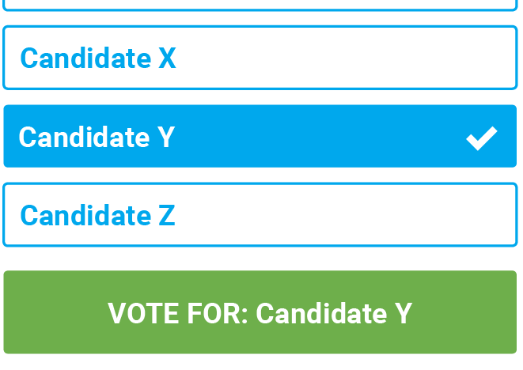
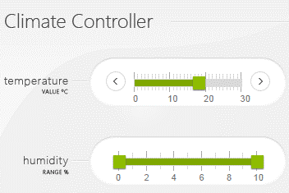
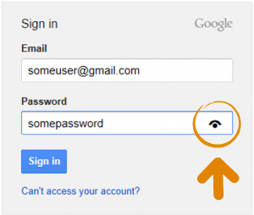
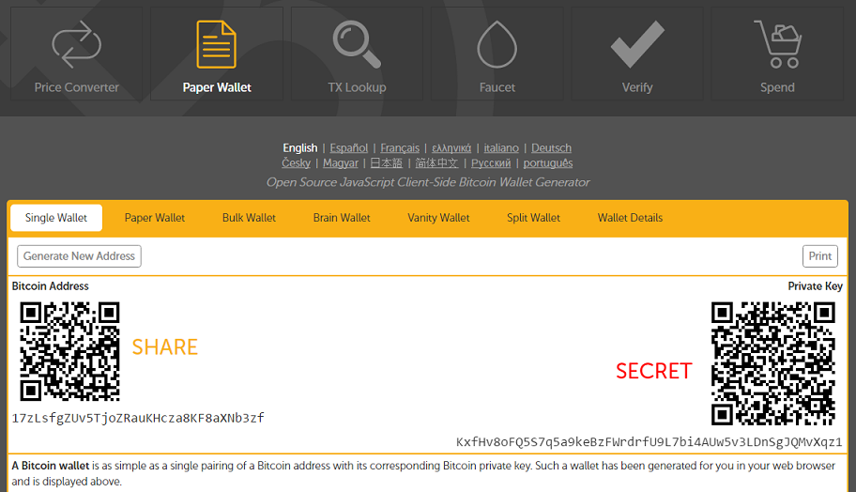
Motivation

Slide 3
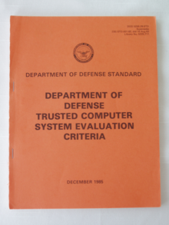
Definition
The TCB shall support a trusted communication path between itself and user for initial login and authentication. Communications via this path shall be initiated exclusively by a user.
- Trusted Computer System Evaluation Criteria (TCSEC) by US DoD (1985)

Slide 4








What is Trusted Path?
TEE
User
HIDs
Host
Remote server

Slide 5
What Would You Expect from a Trusted Path?
All my inputs must reach the specified endpoint unmodified (and possibly hidden)
All the outputs I see must be originated from the specified sender unmodified (possibly hidden)

Slide 6
How to Build Trusted Path?
Transaction confirmation devices
Uni-directional trusted path (UTP)
Trusted intermediators
Hypervisor
Overshadow, SGXIO
External trusted hardware
Fidelius, IntegriKey
System TEE
Vbutton, TruZ-Droid

Slide 7


Transaction Confirmation Devices
Simple to develop
Easy to use for end-users
Widely deployed

Slide 8






Transaction Confirmation Devices: What is bad about it?
Habituation error
Bad Usability
Complex UI

Slide 9
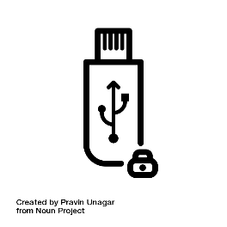






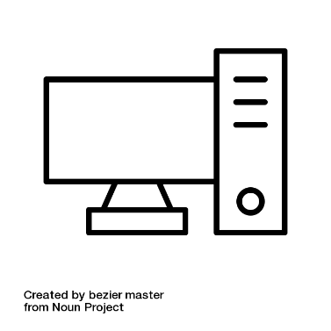
External Devices - IntegriKey
Keystroke
Trusted embedded device
Keyboard
Forwarded
keystroke
Keystroke via
Secure channel
Application-level
payload
Input trace match
Compromised host
Remote server

Slide 10
IntegriKey – Attack by an Anonymous Reviewer
100
100
10
0
1000
100
User sees 100
Device records 1000
Host sends 1000

Slide 11
Observation 1
The lack of output integrity – the render of user inputs on the screen – compromises input integrity.

Slide 12
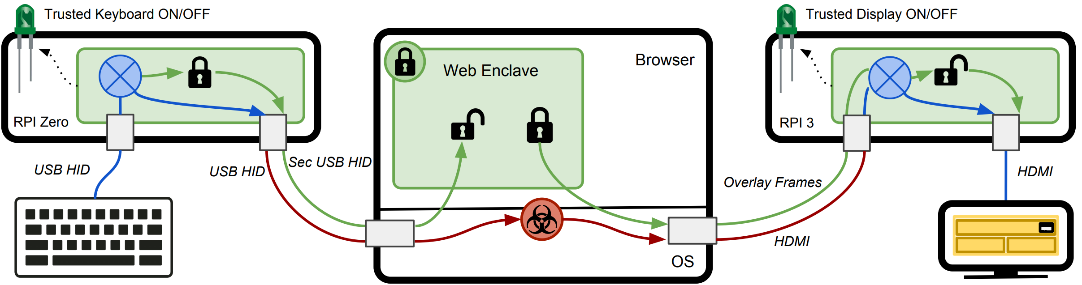
Fidelius – Output Integrity

Slide 13
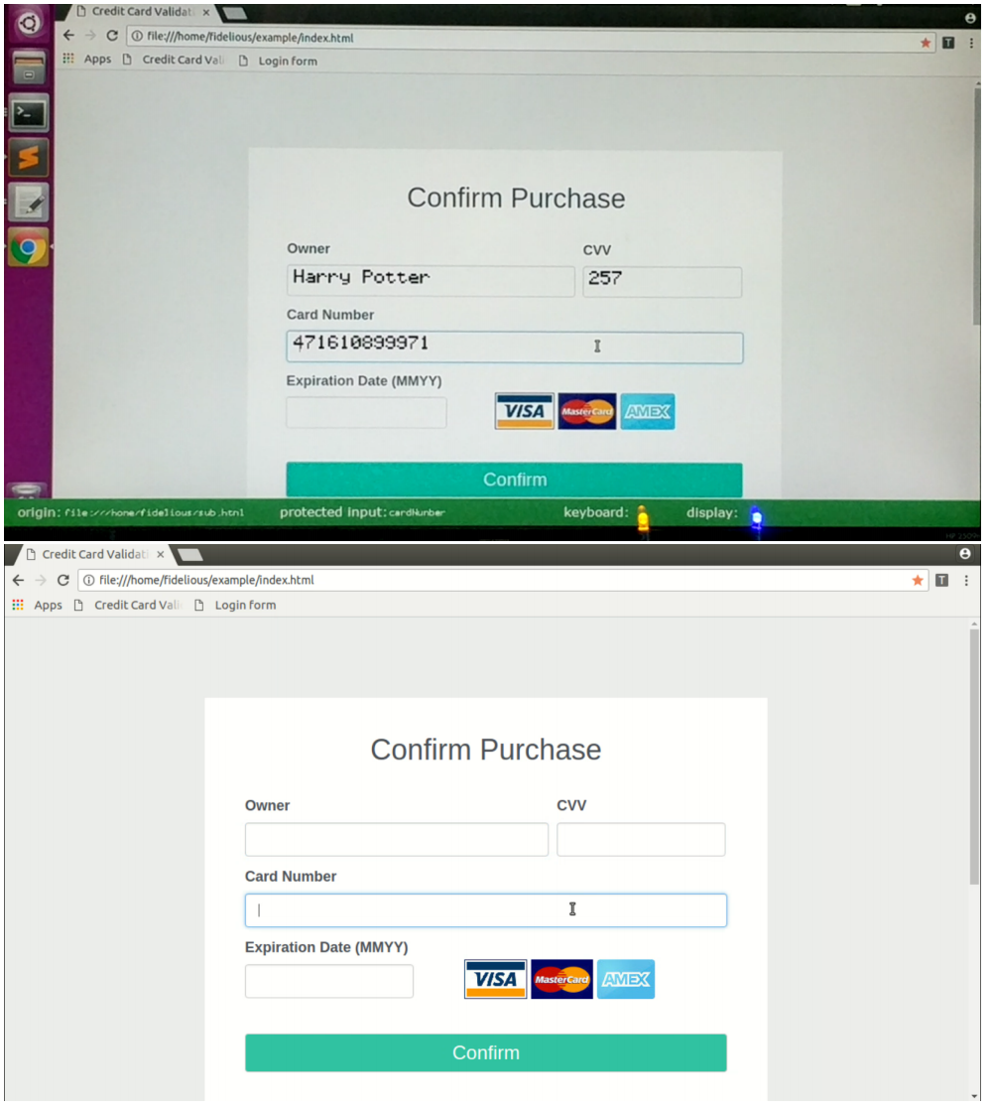
Output Integrity

Slide 14
Fidelius : Attack 1

Slide 15
Observation 2
If the protected output is provided out-of-context, users are more likely not to verify it. Therefore input integrity can be violated.

Slide 16
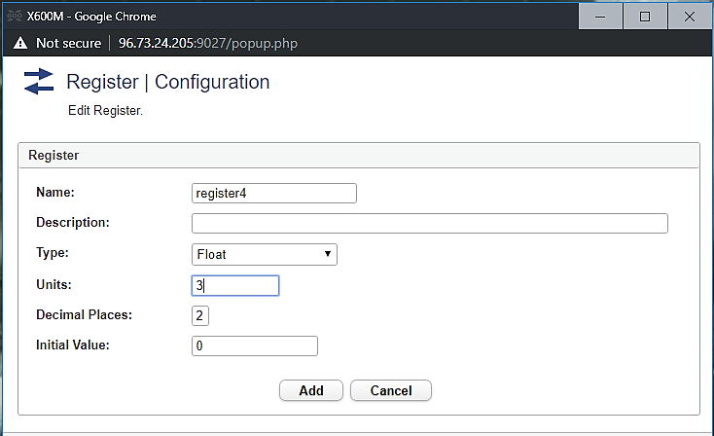
Fidelius: Attack 2
Early form submission attack
Textbox in focus
OS triggers click

Slide 17
Observation 3
If not all the modalities of inputs are secured simultaneously, none of them can be fully secured.

Slide 18
Requirements of Security and Functional Properties
R1. Inter-dependency between input and output
R2. Inter-dependency between all input modalities
R3a. No cognitive load for IO integrity
R3b. User attention for IO confidentiality
R4. Small trust assumptions and deployability

Slide 19
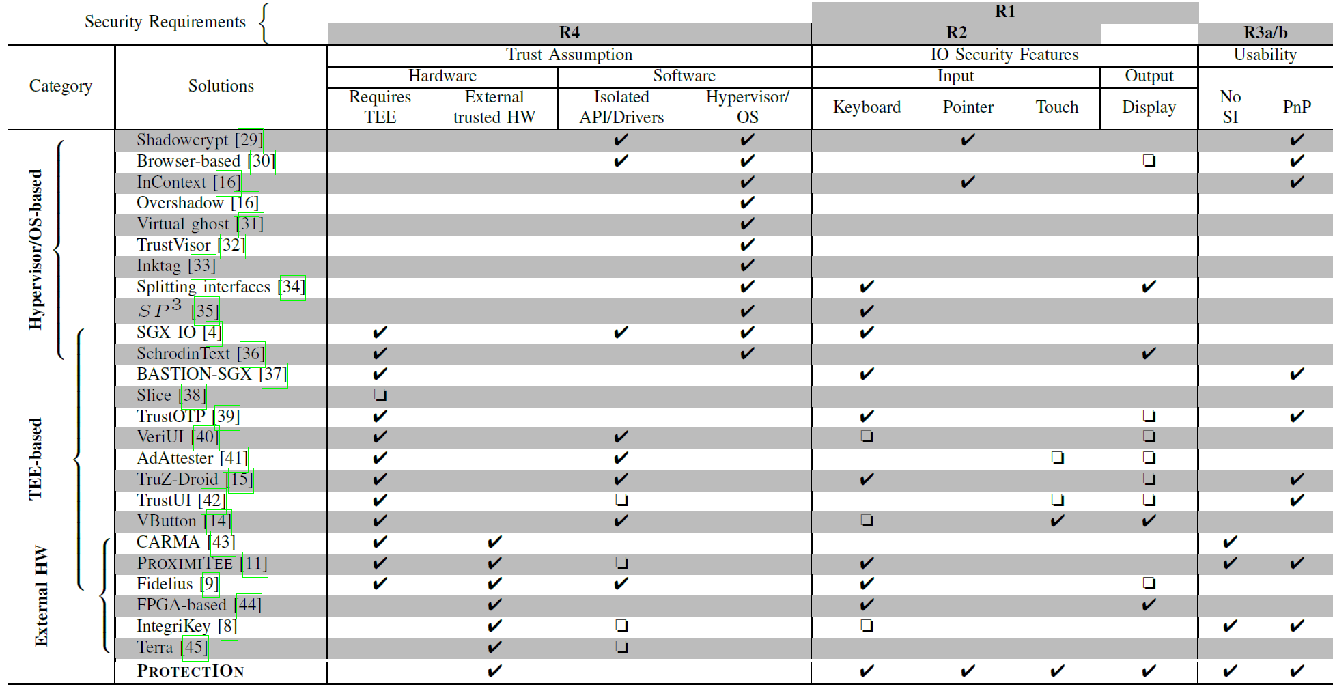
Other Trusted Path Solutions

Slide 20
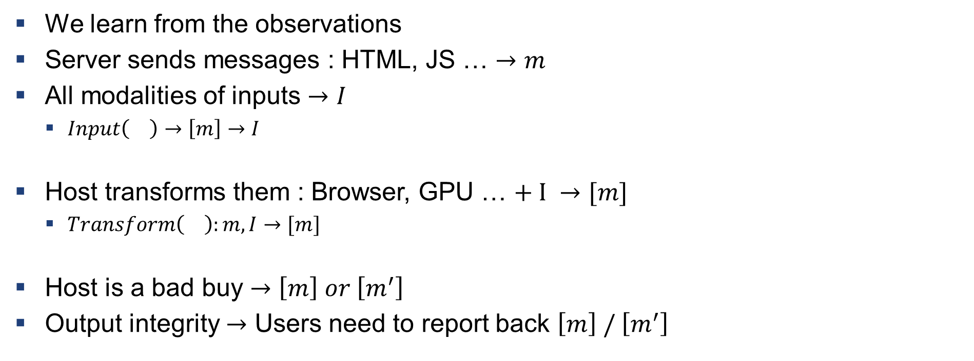
How to Build a Trusted Path
We learn from the observations
Server sends messages : HTML, JS … $→m$
All modalities of inputs $→I$
$Input\left(\right)→\left[m\right]→I$
Host transforms them : Browser, GPU … $+ I →[m]$
$Transform\left(\right):m,I→[m]$
Host is a bad buy $→\left[m\right] or \left[m^{′}\right]$
Output integrity $→$ Users need to report back $\left[m\right] / \left[m^{′}\right]$

Slide 21
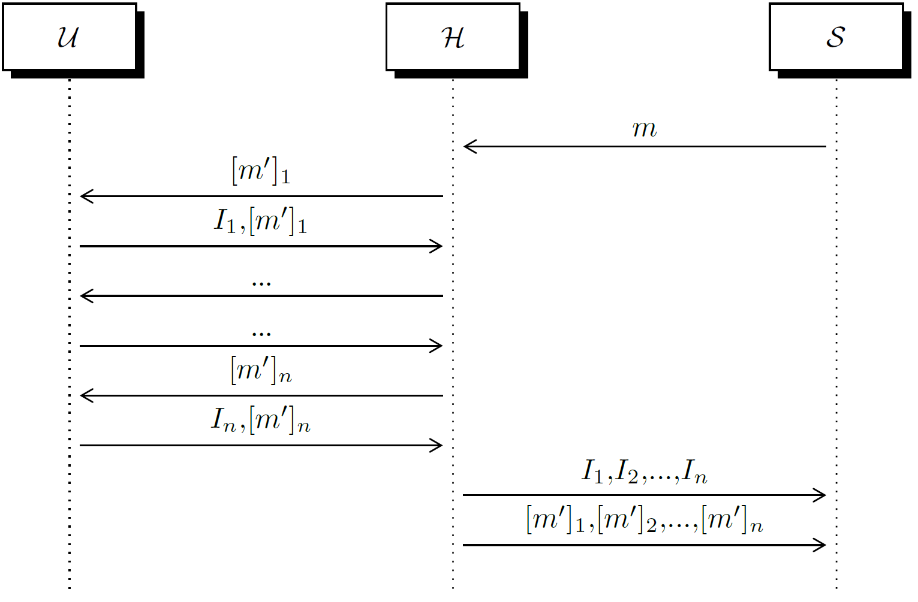
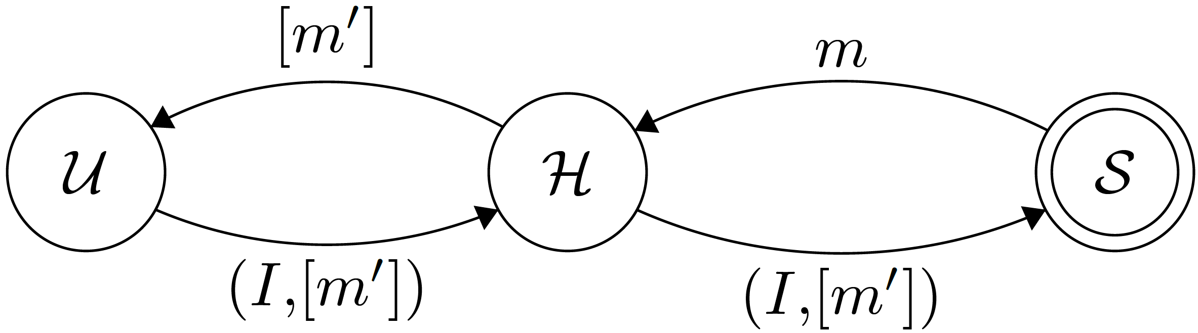
Trusted Path Interactions

Slide 22
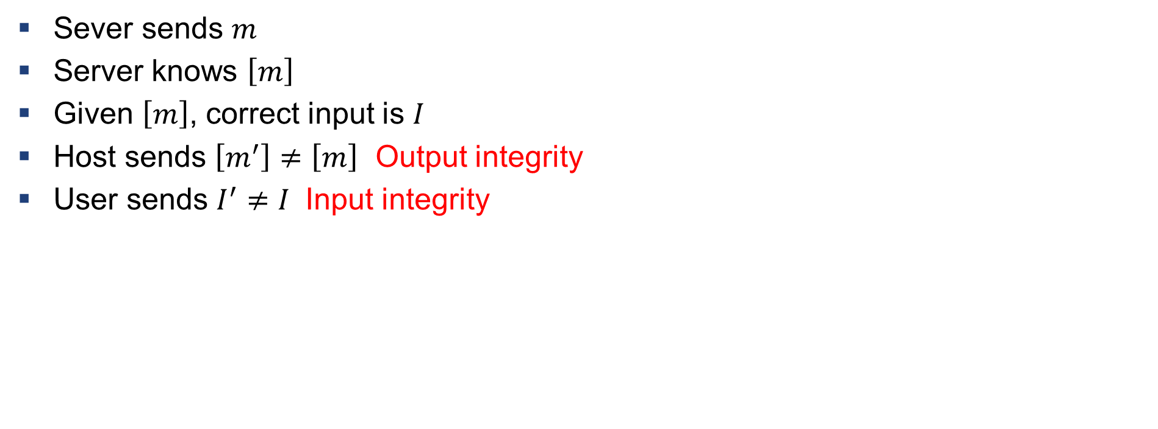
Definition: Violation of Input/output Integrity
Sever sends $m$
Server knows $\left[m\right]$
Given $\left[m\right]$, correct input is $I$
Host sends $\left[m^{′}\right]≠\left[m\right]$ Output integrity
User sends $I^{′}≠I$ Input integrity

Slide 23
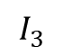
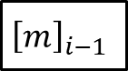
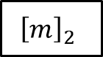
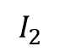
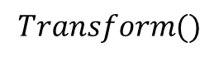
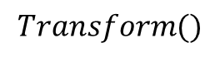
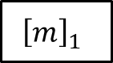
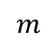
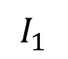
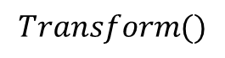
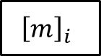

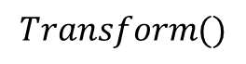
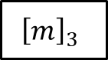
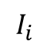
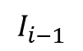
Verification
$$m$$
$$Transform()$$
$${\left[m\right]}_{1}$$
$${\left[m\right]}_{2}$$
$${\left[m\right]}_{3}$$
$${\left[m\right]}_{i−1}$$
$${\left[m\right]}_{i}$$
$$…$$
$$I_{1}$$
$$I_{2}$$
$$I_{3}$$
$$I_{i−1}$$
$$I_{i}$$
$$Transform()$$
$$Transform()$$
$$Transform()$$
Anything missing in the chain $→$ IO integrity violation

Slide 24
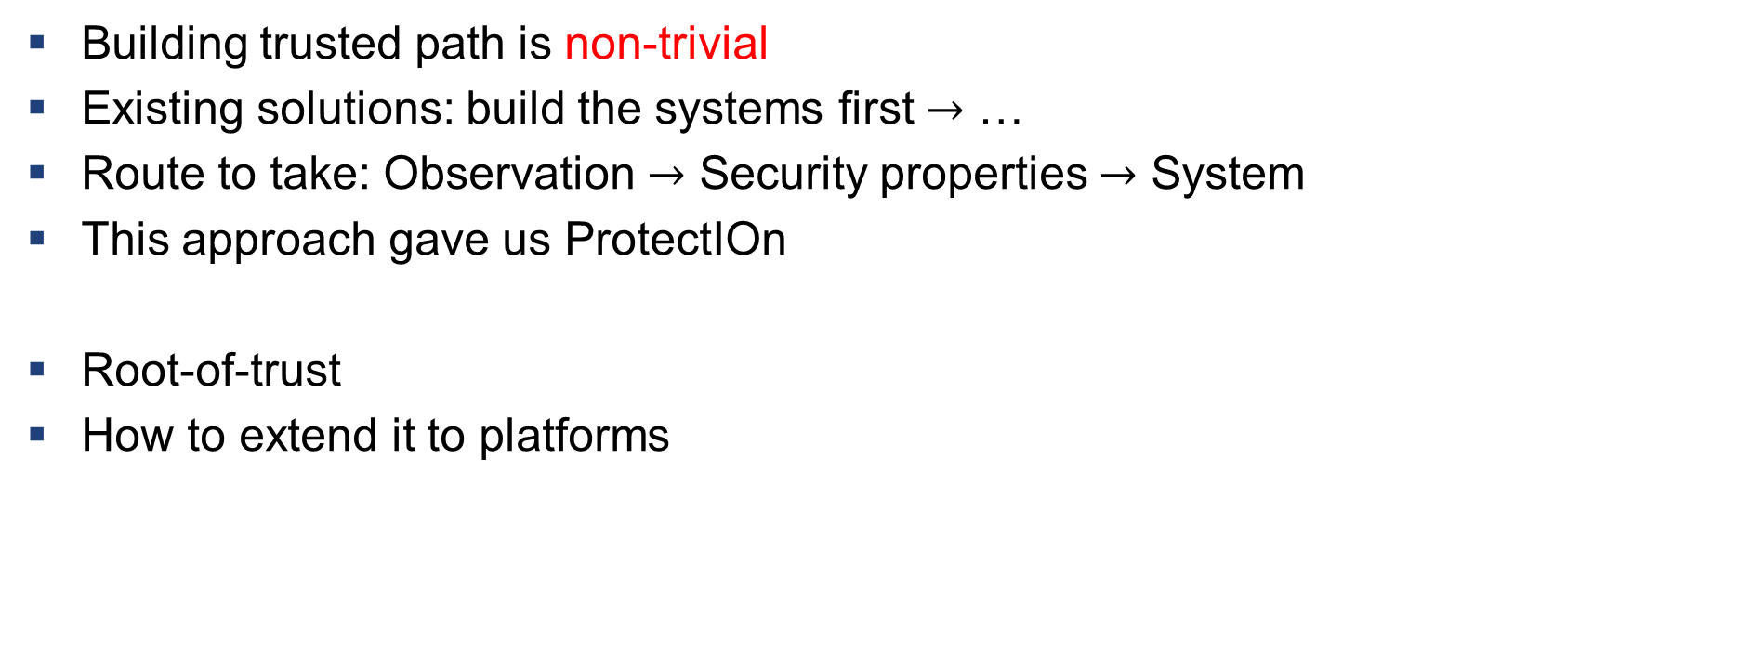
What we learnt?
Building trusted path is non-trivial
Existing solutions: build the systems first $→$ …
Route to take: Observation $→$ Security properties $→$ System
This approach gave us ProtectIOn
Root-of-trust
How to extend it to platforms

Slide 25


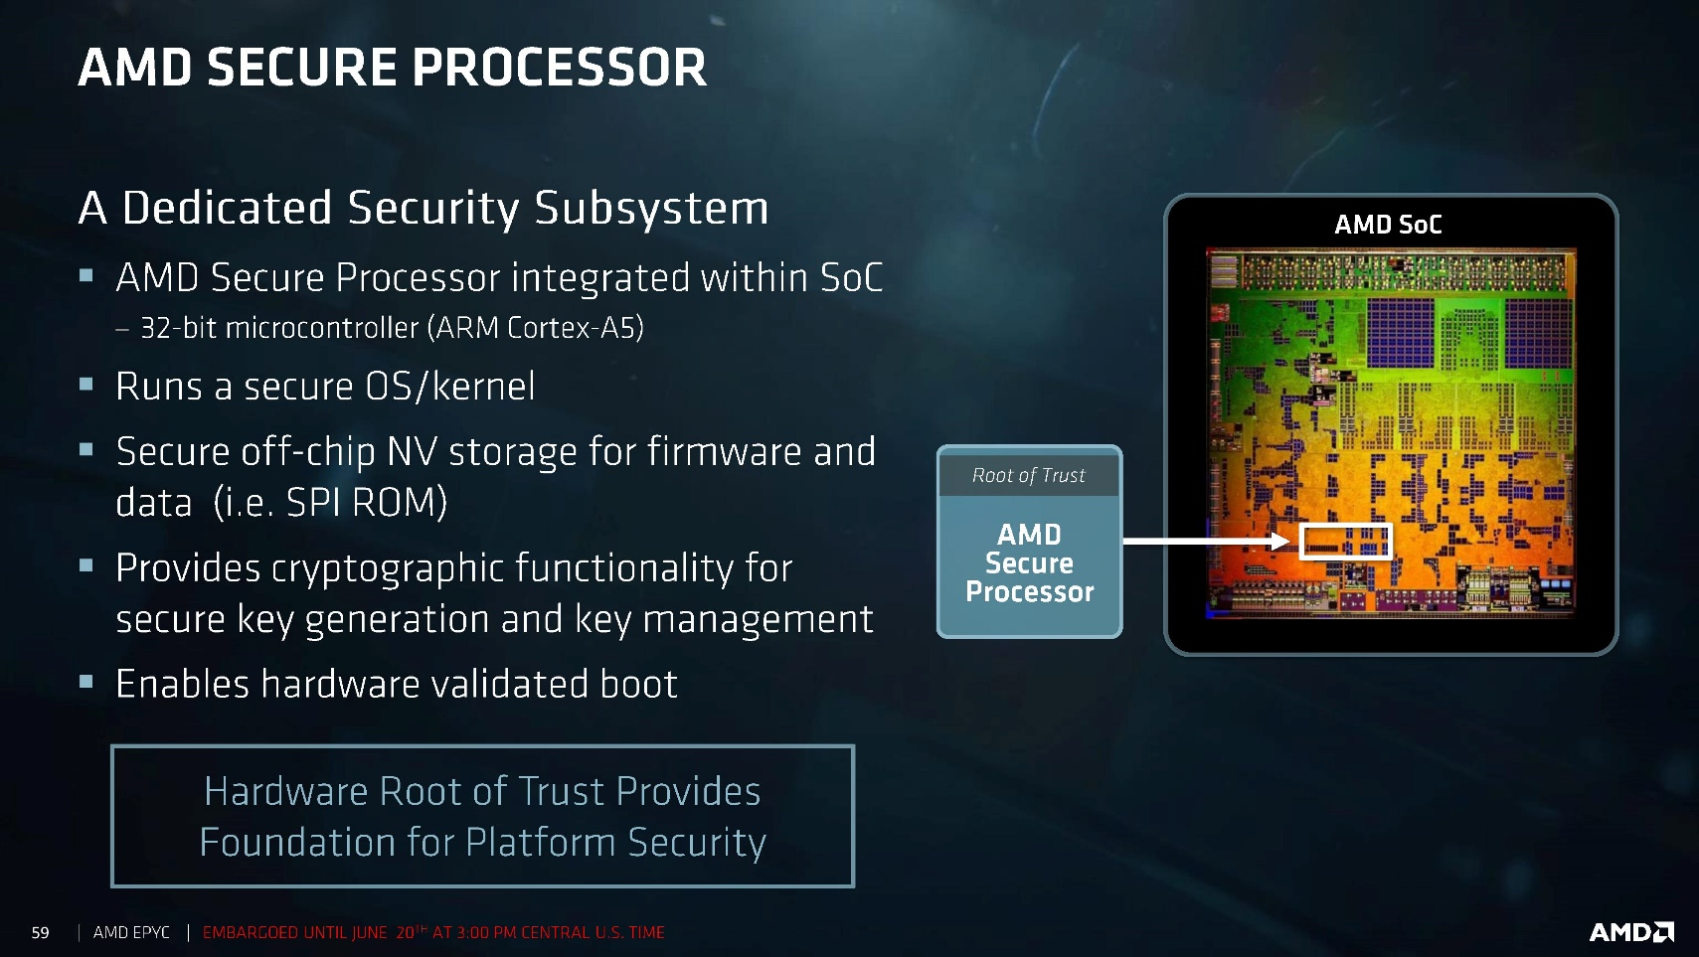

What is Missing?

Slide 26
What is Missing?
Trusted path is still a problem

Slide 27
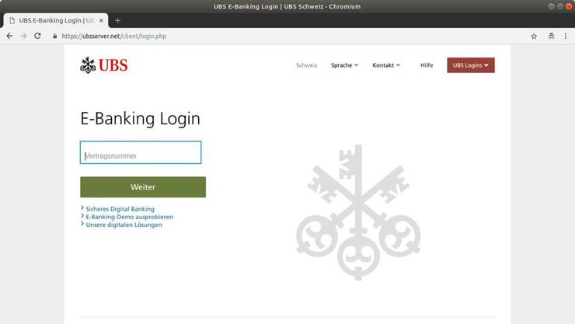

What is Missing?
“I want my UBS app to have exclusive access to my keyboard.”

Slide 28
What is Missing?
Peripherals are oblivious to the applications
Keyboard: “Am I getting accessed by the UBS app or the OS?”
Metered peripheral access
“I want to charge the client based on the number of GPU cores used by the ML app.”

Slide 29
Platform Awareness
Assurance of the state of the platform
State: CPU + Peripherals
State is determined by the attestation
“I know that I am running a proper version of the enclave that is using a certified peripheral that is running a proper firmware.”

Slide 30






Basic Building blocks
Application enclave (AE)
Controller enclave (AE)
Modified Peripheral

Slide 31


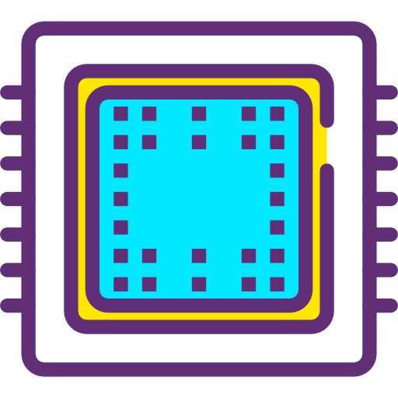




Basic Building Blocks
DSP
Modified peripheral

Slide 32



Platform Awareness: Trust Model
SM

Slide 33
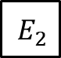
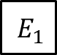
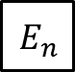
Primitives
Communication through shared memory
Peripherals are either DMA or memory-mapped
Attestation
AE
CE
Peripherals
Slave
Master
Slave
Master
Slave
Master
$$E_{1}$$
$$E_{2}$$
…
$$E_{n}$$

Slide 34


Shared Memory Communication

Slide 35
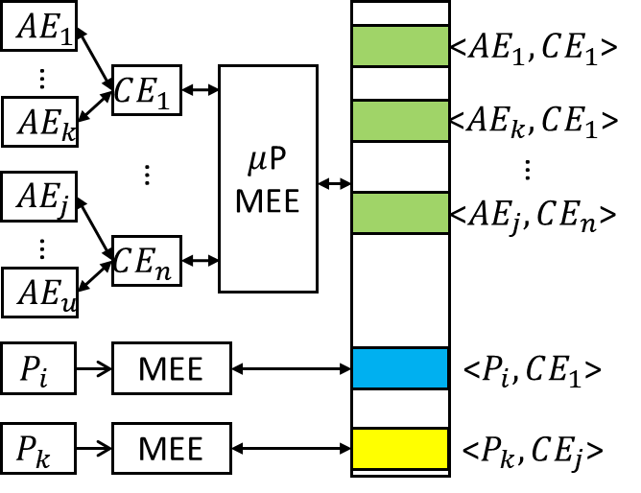
Architecture

Slide 36
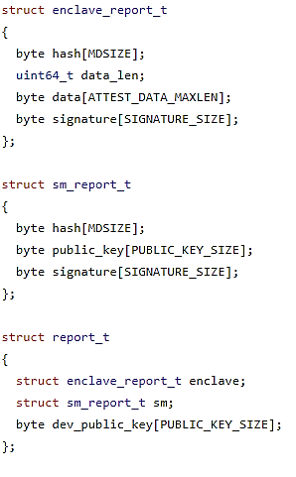
Chained Attestation: Report Structure
Enclave report
AE report contains CE report
CE contains peripheral report
All of them are signed by the platform key

Slide 37
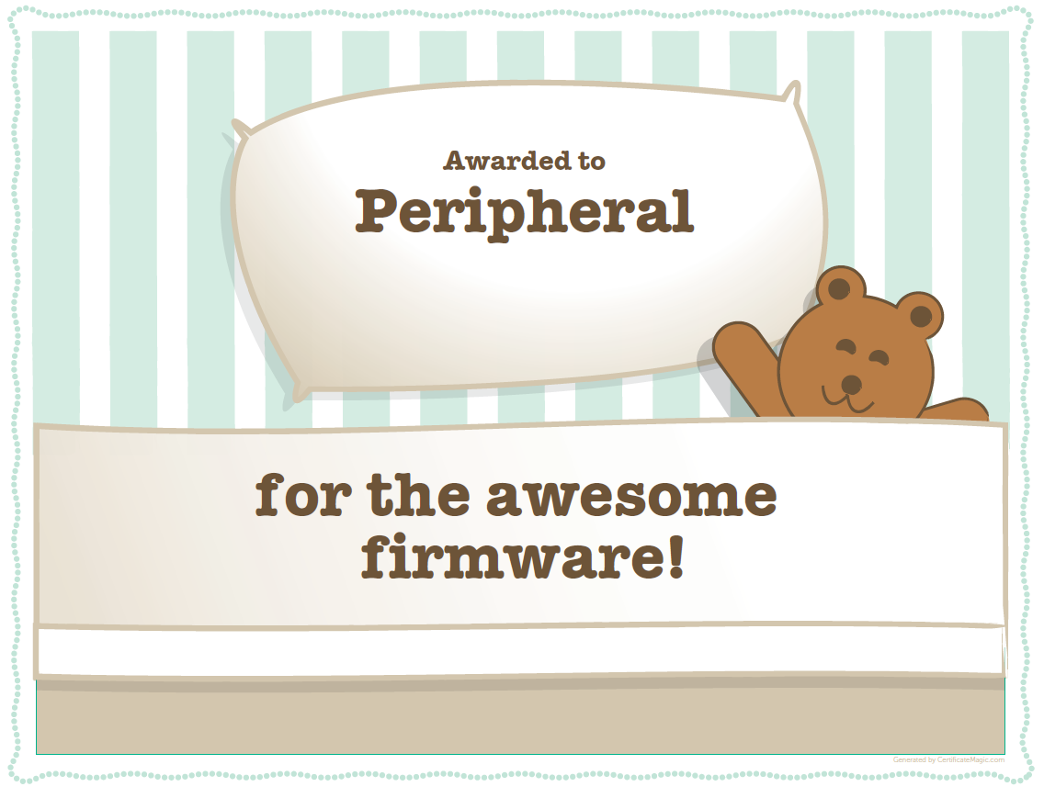

Chained Attestation
SM

Slide 38


